Slide 1
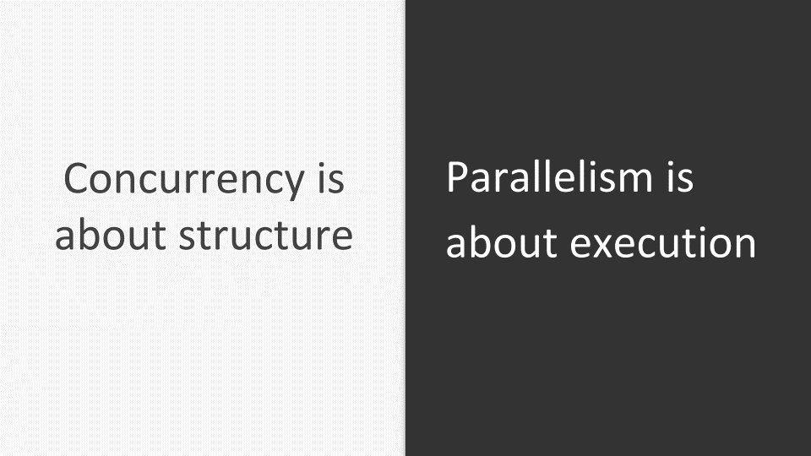


Parallel Programming
AUTHOR: Rafael García Cuéllar

Slide 2

Discovering Python’s parallel programming tools & Python GIL
Modules
imports
The Python threading module
The Python multiprocessing module
The Python concurrent.futures package (New in version 3.2)
The Python subprocess module
The Python sched module
The Python queue module
import threading
import multiprocessing
import concurrent.futures
import subprocess
import subprocess
import queue

Slide 3
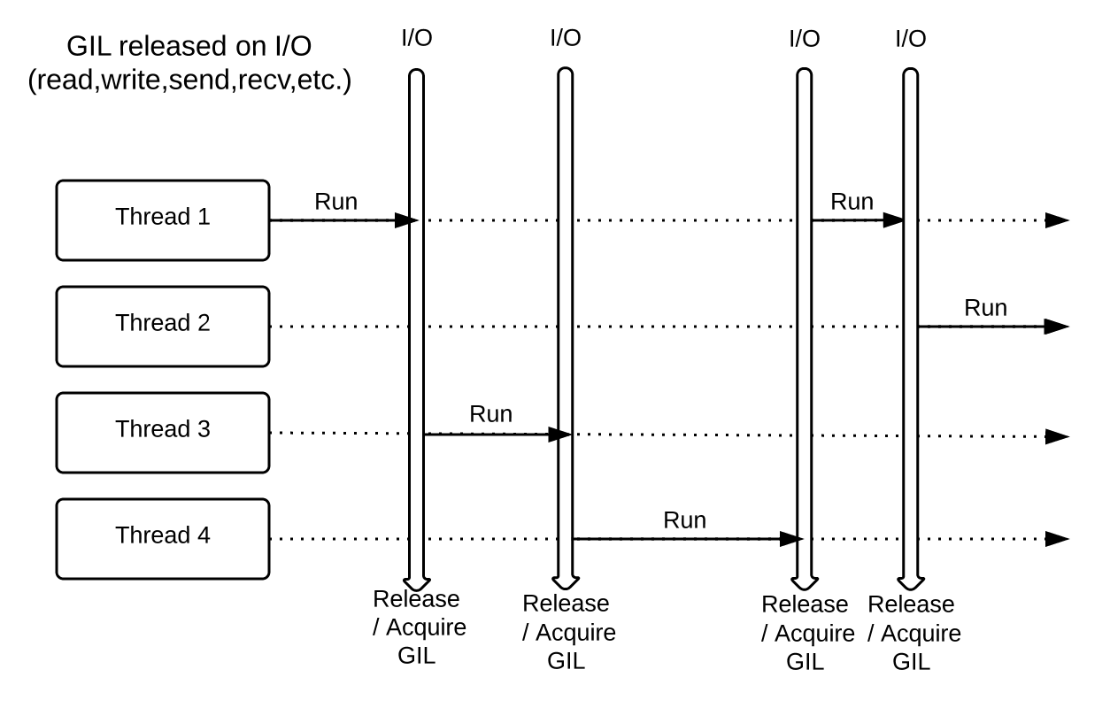



Discovering Python’s parallel programming tools & Python GIL
Global interpreter lock (GIL)
Parallel execution is forbidden
There is a "global interpreter lock"
The GIL ensures that only one thread
runs in the interpreter at once
Simplifies many low-level details
(memory management, C extensions, etc.)
More efficient
global interpreter lock ??
Discussion: the Python
LESS efficient

Slide 4

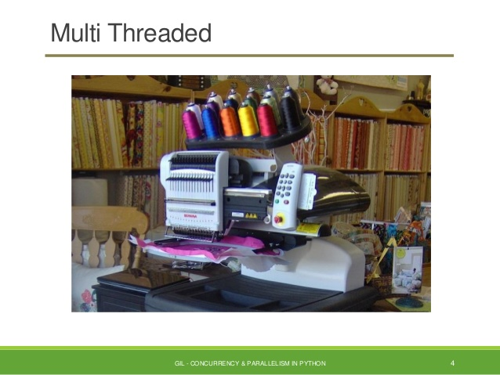

The python threading module
Main thread – Sequential Execution
Multi-threading – Parallel and Concurrency Execution
Thread-Local Data
Thread Objects
Lock Objects
Rlock Objects
Condition Objects
Semaphore Objects
Event Objects
Timer Objetcs
Barrier Objects
Thread-based Parallelism
import threading

Slide 5


The python threading module
Multi-Threading Example

Slide 6
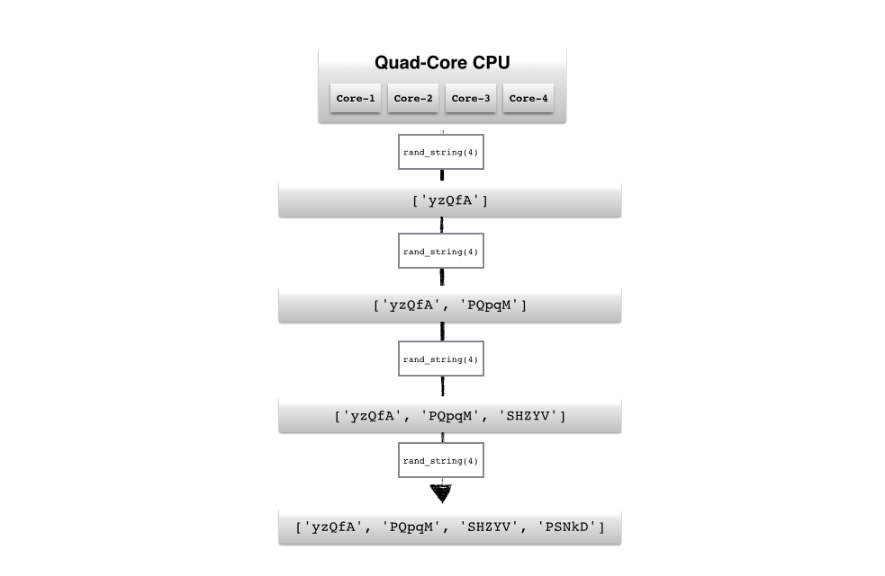
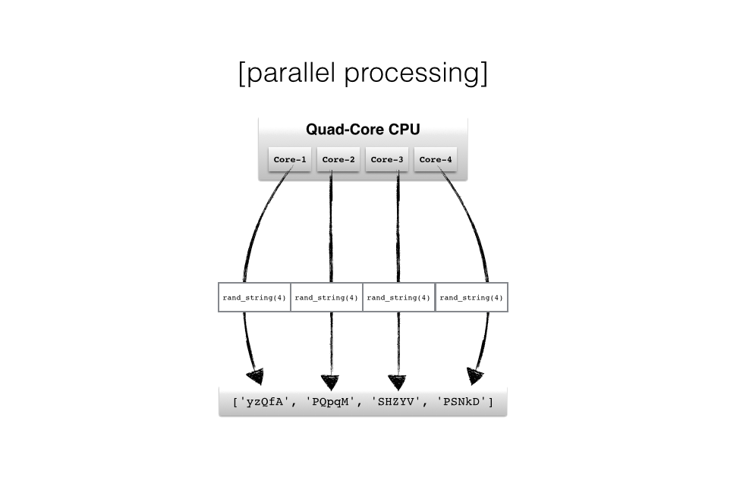
The python MULTIPROCESSING module
multi processing !!
Serial processing
Process and exceptions
Pipes and Queues
Synchronization
Shared Types
Managers
Process Pools
Listener and Clients
Proxy Objects
Authentication keys
…
Process-based Parallelism
import multiprocessing

Slide 7

The python MULTIPROCESSING module
Multi-Processing Example

Slide 8
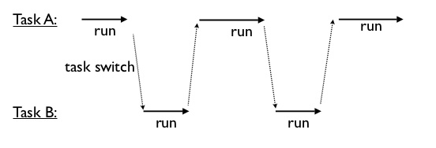
The python concurrent module
Executor Objects
ThreadPoolExecutor
ProcessPoolExecutor
Future Objects
Exection classes
Module Functions
Launching Parallel Tasks
Concurrency typically implies “multitasking” by
David Beazly
import concurrent
import concurrent.futures

Slide 9

The python CONCURRENT module
Concurrent Example

Slide 10




QUESTIONS, SUGGESTIONS & SOURCES
Github Repository: https://github.com/rafagarciac/ParallelProgrammingPython

